Slide 1
Endometriosis: prevalence & challenges & its Medical Management

Slide 2
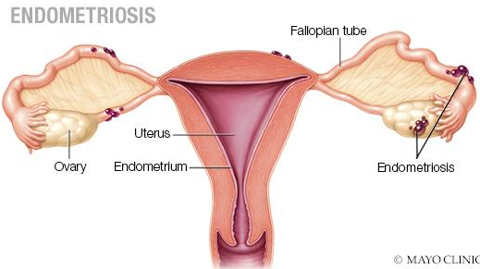
Introduction
Definition: presence of endometrial‐like tissue outside the uterus, which induces a chronic, inflammatory reaction (ESHRE, 2013)
Endometriosis is a long-term, recurrent, debilitating disease experienced by approximately 5%-10% women.

Slide 3
Endometriosis Facts

Slide 4
Endometriosis Facts
Peak incidence in the age group of 25-30 yrs
20-40% of infertile women & 5% of fertile women
Also found in 6-43% of women undergoing laparoscopic sterilization
Does NOT Discriminate by Race and Social status

Slide 5
Etiology : Disease of Theories
Sampson: “Retrograde Menstruation”
Hematologic Spread
Lymphatic Spread
Coelomic metaplasia
Genetic Factors
Immune Factors
Combination of the above
No Single theory explains etiology of Endometriosis

Slide 6
Clinical Presentation
Asymptomatic
Chronic Pelvic Pain, Dysmenorrhea
Abnormal Uterine Bleeding
Deep Dyspareunia
Misc: Tenesmus, Hematuria, LBP, Hemoptysis
Classic triad- dysmenorrhea, dyspareunia and infertility
Infertility
  20-50% of infertile diagnosed as endometriosis ( Macer and Taylor. Obs Gyn Cl NA.2012)
  30-50% with endometriosis are infertile (ASRM, 2008)
  MFR reduced in women with endometriosis (2-10% vs 15-20% in fertile women)
Women with endometriosis have pain and infertility at the same time, which complicates the choice of treatment

Slide 7

Endometriosis: Risk factors
High estrogen exposure
  Early menarche
  Late menopause
  Nulliparity
  Shorter lactation intervals
Genetic predisposition
  1st degree relative with endometriosis
  Mullerian anomalies
  White race (compared to black race)
High risk of retrograde menstruation
  Prolonged menstruation (> 5 days)
  Shorter menstrual cycles (< 28 days)
Schrager S, et al. Am Fam Physician. 2013;87(2):107-113.
Notes:
It has been reported that the risk of endometriosis is six times higher in first-degree relatives of women with severe endometriosis.⁹ However, a more recent case-control study showed that the familial impact on the incidence of endometriosis is not significant.¹⁸
Early menarche and late menopause, which lead to increased exposure to menstruation, are commonly cited risk factors for endometriosis.^{5,19} However, epidemiologic studies are equivocal as to whether these are true risk factors or findings associated with the disease itself.²⁰ Low body mass index^{21,22} and higher caffeine or alcohol consumption
Oral contraceptives and regular exercise (i.e., more than four hours per week) may decrease the risk

Slide 8
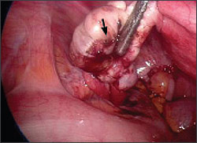
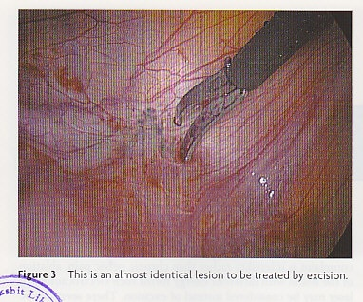
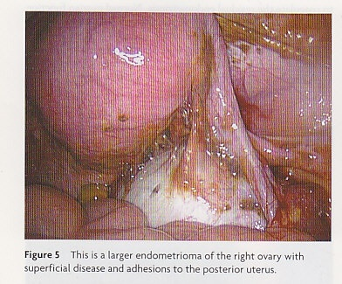
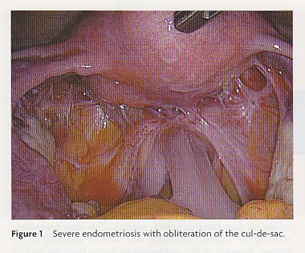
Endometriosis- classification of lesions
Superficial
  Implants (Peritoneum, ovarian surface)
  Adhesions
Ovarian endometriomas
Deep infiltrating endometriosis (DIE)->5 mm in depth
  Rectovaginal septum
  Rectosigmoid
  Uterosacral
  Rectum
  Bladder
  vagina
Adenomyosis
Peritoneal implants
Ovarian endometrioma
Deep infiltrating endometriosis

Slide 9
Causes of Infertility in Endometriosis
Ovulatory dysfunction | Interference with implantation
Abnormal folliculogenesis | Endometrial dysfunction
Anovulation
Luteal phase defect
Luteinised unruptured follicle syndrome
Immunological alterations | Mechanical factors
Decreased sperm survival | Anatomical distortion of tubes
Altered immunity | Altered tubal motility
 | Interference with ovum pick up
 | Peritubal adhesions
Peritoneal factors | Interference with coital function
Intraperitoneal inflammation | Dyspareunia
Local production of prostaglandins / Cytokines
 | Sperm inactivation
 | Phagocytosis by macrophages
 | Inactivation by antibodies

Slide 10
Diagnosis
Imaging
  TVS
  MRI
  Trans-rectal USG
Laparoscopy-GOLD Standard
  Site
  Type
  extent

Slide 11
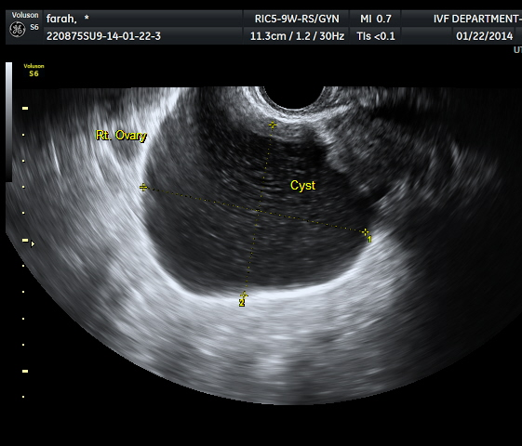
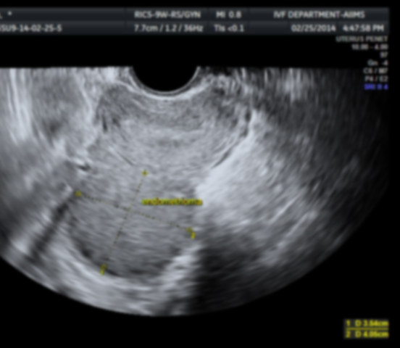
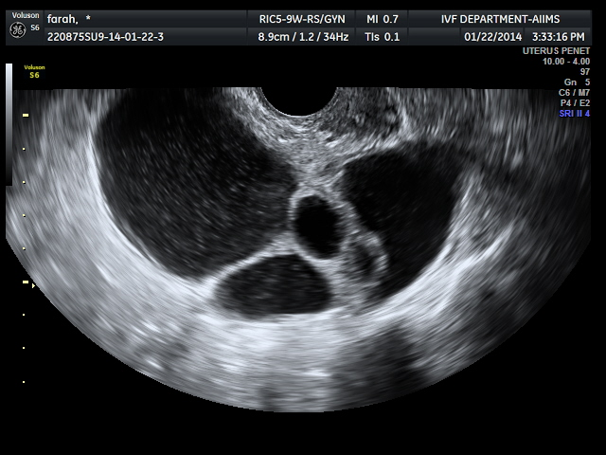
Imaging-TVS-ENDOMETRIOMA
Diffuse low level internal echo
Multi loclularity
  Similar appearance in Hgic cyst, dermoid cyst, epithelial ovarian tumors,
Hyper echoic wall foci

Slide 12
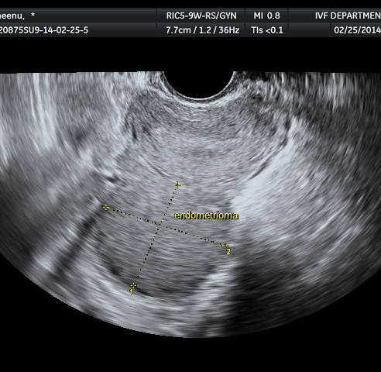
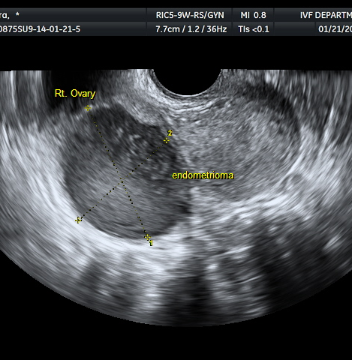
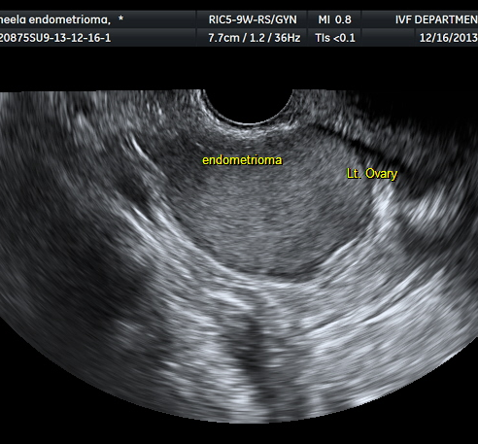
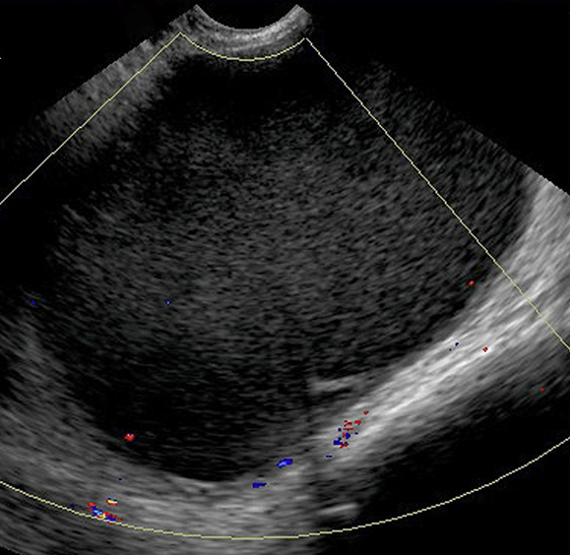
USG & ENDOMETRIOSIS

Slide 13
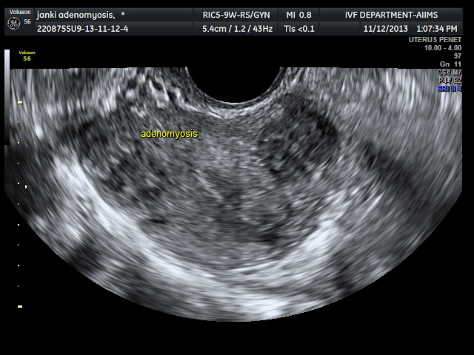
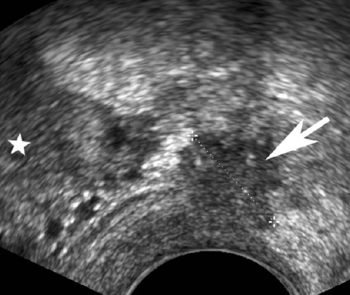
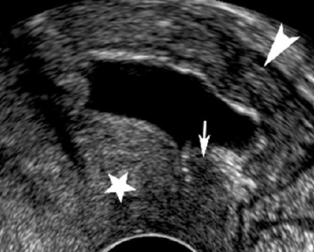
Imaging endometriosis-TVS
Adherence of ovaries to uterus
Prolapse of ovaries
Associated adenomyosis
DIE on TVS
Endometriotic nodule in USL
Endometriotic nodule in RVS

Slide 14
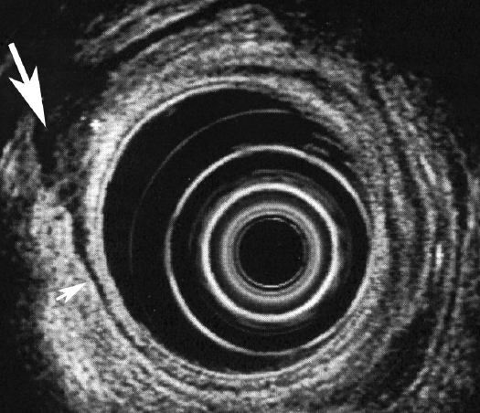
Trans-rectal US (TRS)
Diagnosis of Recto vaginal endometriosis
Senstivity-80-100%, specificity-96-100%
TRS is better than MRI in diagnosis of rectal involvement with DIE.
(Chapron et al, 2004)
rectal endometriosis in rectal wall

Slide 15
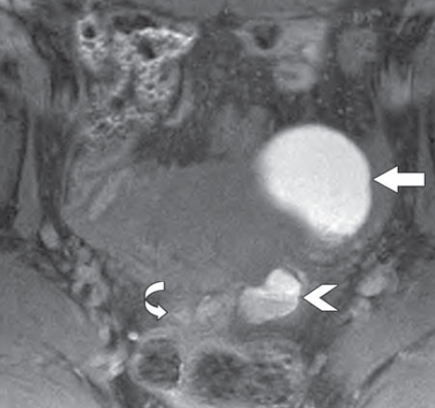
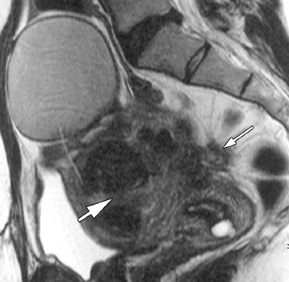
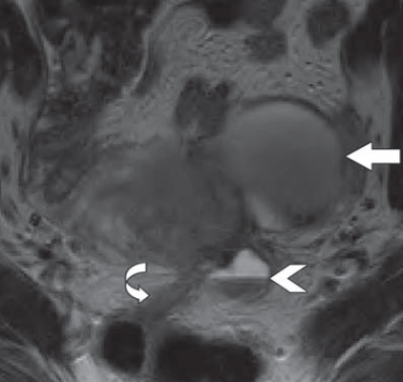
MRI-ENDOMETRIOSIS
Endometrioma
DIE
T1 WSE-hyperintense , T2 WSE- hypointense
Typical appearance- “grain de café”
T1 weighted fat
suppressed image
T2 WSE with large endometrioma, USL nodule, fibroids in uterus
T2 weighted image

Slide 16
Imaging modalities
NICE recommendations on imaging
  MRI- not a primary imaging tool
  Consider for DIE- extent of involvement, involving the bowel, bladder or ureter
  Ensure that pelvic MRI scans are interpreted by a healthcare professional with specialist expertise in gynecological imaging
  NICE guideline [NG73], 2017

Slide 17
Imaging guidelines-ESHRE

Slide 18
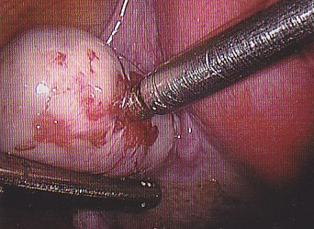
Laparoscopy - visual inspection
Peritoneal implants
Superficial implants
Ovarian endometrioma
Deep infiltrating endometriosis

Slide 19
Scoring Endometriosis
Acosta’s
Kistner’s
Buttram’s
AFS (1979)
r AFS (1997)
Endometriosis Fertility Index (2009)
ENZIAN score (2011)

Slide 20
Scoring in rASRM (1997)
site | endometriosis | 1 cm | 1-3cm | >3cm
peritoneum | Superficial deep | 1 2 | 2 4 | 4 6
ovary | Rt superficial deep | 1 4 | 2 16 | 4 20
 | Lt superficial deep | 1 4 | 2 16 | 4 20
POD | PARTIAL | 4 | COMPLETE | 40
 | adhesions | <1/3 | 1/3-2/3 | >2/3
tube | Rt flimsy dense | 1 4 | 2 8 | 4 16
 | Lt flimsy dense | 1 4 | 2 8 | 4 16
ovary | Rt flimsy dense | 1 4 | 2 8 | 4 16
 | Lt flimsy dense | 1 4 | 2 8 | 4 16

Slide 21
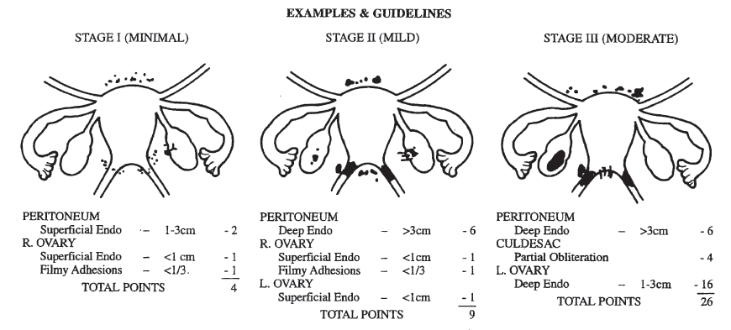
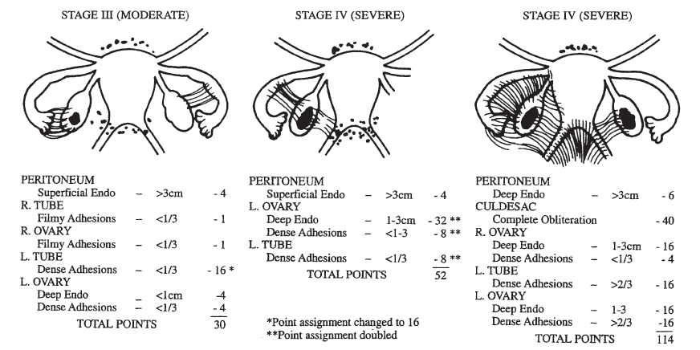
Revised ASRM (scoring)
stage | score
minimal | 1-4
mild | 5-15
moderate | 16-40
severe | >40
AFS scoring | Revised ASRM scoring
weighted point score: presence of adhesions, extent of endometriosis | category for minimal disease, eliminated the extensive disease category,
presence of filmy versus dense adhesions. sizes of endometriomas | Quantification of the number of adhesions
deeply inﬁltrating endometriosis, retroperitoneal structures, involvement of other organ not included | complete enclosure of the fimbria- moderate Cul-de-sac obliteration- severe disease

Slide 22
Why treat endometriosis?
“Chronic painful debilitating condition affecting QoL”
38% reduction on work productivity, reduced number of work hrs
30% do not continue employment
50%
Sepulcri RP, et al. Eur J Obstet Gynecol Reprod Biol. 2009; 142(1): 53–56/
Gao X, et al. Fertil Steril. 2006; 86(6): 1561–1572.

Slide 23

Endometriosis: Treatment goals
Relieve pain
Slow growth of endometriosis tissue
Improve fertility
Prevent disease recurrence
http://www.nhs.uk/Conditions/Endometriosis/Pages/Treatment.aspx

Slide 24
Dilemmas at treatment
Chronic, progressive disease
Infertility and pain have different treatment modality
Current scoring system do not correlate well with treatment outcome
Recurrence
  5 to 20%/yr
  Cumulative rate 40% after 5 yrs (ESHRE 2013)
Recurrence after both hormonal and surgical treatment
Elimination of implants by surgical or medical treatment provides temporary relief in pain. Fertility improvement?
Controversy around surgical methods

Slide 25
Treatment Objective
Treating pain
Treating infertility

Slide 26
Management of Pain
Analgesics
Hormonal treatment
Surgery
Alternative/ complementary therapy

Slide 27
Analgesics
NSAIDs effective in relieving pain
Aspirin, Naproxen, Ibuprofen, Mefenamic acid
Appear to be more effective than PCM
Can cause indigestion, GI, drowsiness
No evidence to support better role of selective COX-2 inhibitors
NSAIDS are the only medical option in women desirous of pregnancy who have painful endometriosis (Bedaiwy MA, Fert. Ster 2017)
Marjoribanks et al. Cochrane Database Syst Rev. 2010 Jan 20;(1):CD001751

Slide 28
Treating pain
SURGICAL
  Implants
  Endometrioma
  DIE
  Pre-sacral neurectomy
HORMONAL
  OC
  Progestogens
  GnRH- agonist
  GnRH- antag
  SPRM
  SERM
NON-HORMONAL
  AI
  Immunomodulators
  Others

Slide 29
Hormonal therapy for pain
Act through diverse endocrine pathways BUT achieve a similar end-result
  Interference with pituitary gonadal stimulation
  Anovulation
  Induction of a steady hormonal milieu
  Reduction/ suppression of menstrual flow.
Hypo- or atrophic glandular state is temporary
No definitive cyto-reductive action by altering ovarian steroid levels
EFFECTIVE DRUGS WITH NO S/E JUST DO NOT EXIST
Goal is complete elimination of pain BUT without compromising safety, quality of life, and economic stability

Slide 30
FIRST LINE AGENTS
DRUG | Evidence | Recommendation
NSAIDs (paracetamol) | Allen et al., 2009 | A
PROGESTINS Traditional:- |  | A
MPA (oral,depot) | Crosignani et al 2006; Schlaff et al 2006
Nor-Ethisterone | Vercellini et al 2011; Brown et al 2012
NEWER PROGESTINS
Dienogest | Cosson et al 2002; Harada et al 2009; Momoeda et al 2009; Ko¨ hler et al., 2010; Strowitzki et al 2010a, b, 2012; Petraglia et al 2012
COCs | Davis et al 2007; Harada et al 2008; Guzick et al 2011; Vercellini et al 2011 | B
Vaginal Contraceptive Ring, Transdermal Patch | Vercellini et al., 2010 a,b | C

Slide 31
SECOND LINE AGENTS
DRUG | Evidence | Recommendation
GnRH-a with Add Back Therapy | Brown et al., 2010 | A
LNG-IUS | Abou-Setta et al.,2006; Gomez et al.,2007; Ferriera et al.,2010 | B
Opioid Analgesics
Successful second-line empirical medical treatment may reduce need for surgery

Slide 32
Oral contraceptive pills
Hormonal suppression effective despite estrogen dependent disease
Mechanism of action:
  Inhibit Ovulation inhibition
  Lower Gonadotrophin levels
  Decidualization of implants
  Reduce / abolishes retrograde menstruation
OCPs reduce dysmenorrhea & pelvic pain as primary drugs
Continous administration of OCP to avoid withdrawal bleeding beneficial for pain relief
Used to reduce recurrence post surgery
Vaginal contraceptive ring or transdermal patch effective to reduce dysmenorrhea, dyspareunia & chronic pelvic pain
Vercellini et al., Fertil Steril 2010
Dunselman et al., Hum. Reprod 2014: 29(3): 400-412

Slide 33
OC for pain
Advantages
Cost
Long-term therapy
Disadvantages
Irregular bleeding
Weight gain
Bloating
Breast tenderness
Headache
VTE
Irritability
Standard EE (35-50 µgm)+ P (19 nortestosterone)
Newer EE (20µgm)+P (desogestrel, LNG)
A. Continuous
  - Taken for 6-12 months
  - Symptomatic relief 60-95%
  - Recurrence rate of 17-18% - 1st year
B. Cyclical
  - Protects against development / recurrence
  - Decreased amount of bleeding

Slide 34
OCP for pain relief
Standard vs low dose
Continuous vs cyclical

Slide 35
Standard Vs low dose OC
OC –over express ER and under express PR in ectopic implants
EE in low dose (20-30 µgm) is supra-physiological
Previous use of OC associated with increased risk of endometriosis (DE)
Casper RF. Fert Ster;2017
Low dose improve dysmenorrhea, other pain symptoms, non-menstrual pain and deep dyspareunia
Lowest dose OC (15-20 µgm EE or 1.5 mg 17 β estradiol)

Slide 36
Low dose OC
Minimal withdrawal bleed with low dose
  Retrograde blood flow
  Chances of endometrial fragments X pelvis
  Inflammation
Reduced risk of thrombosis
Do not alter lipid profile
Lowest discontinuation rate compared to P or GnRH-a
Endometriosis: diagnosis and management. NICE guideline NG73. 2017

Slide 37
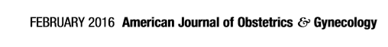
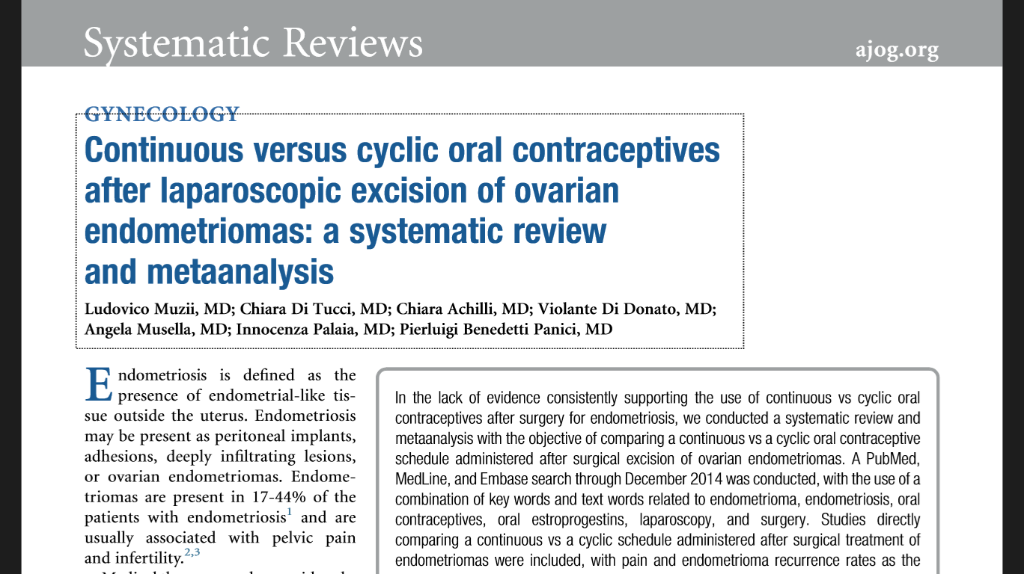

Cochrane Review 2014
Extended or Continous OCP group fared better compared to cyclical OCP for dysmenorrhea, headaches, bloating, tiredness
Similar compliance, contraceptive efficacy & safety profiles between both groups
N = 343
Lower recurrence for dysmenorrhoea with continuous compared to cyclical regimen ( RR 0.24; P= 0.04)
Non significant difference for chronic pelvic pain and dyspareunia
Continuous OCP associated with non significant decrease of cyst recurrence compared with cyclical schedule ( RR 0.54; P= 0.07)

Slide 38
Continuous Vs Cyclical OC
Continuous OC use of advantage
Continuous or cyclic
  No difference as regards pain, deep dysperunia, post-operative recurrence (a)
Erratic bleeding more common with continuous OC
Patients should make choices
Shift from cyclical to continuous
a. Muzii L , et al. Continuous versus cyclic oral contraceptives after laparoscopic excision of ovarian endometriomas: a systematic review and meta-analysis. Am J Obstet Gynecol 2016;214:203–11

Slide 39
Progesterone
Mechanism of Action
Endometrial tissue- glandular atrophy and decidualization
Suppress Gn release – hypoestrogenic state – anovulation
Inhibition of angiogenesis
Anti-inflammatory, decreased markers of PF inflammation
SIDE EFFECTS
Spotting and breakthrough bleeding (upto 50%)
Nausea
Weight gain and increased appetite
Fluid retention
Depression and mood swings (1%-5%)
Mastalgia

Slide 40
Progestins
Drug | Dose
ORAL
MPA | 30-100mg daily
Norethindrone acetate | 5 mg daily
Dydrogesterone | Upto 60mg, 12 days per cycle
Dienogest | 2mg daily
DEPOT PREPARATIONS
DMPA-IM 150 | 150 mg im every 3m
DMPA-SC 104 | 104 mg sc every 3m
Sub-dermal implants (Implanon)
Intrauterine devices (LNG-IUS)

Slide 41
Choosing the progesterone
Preferred for pain relief in DE (recto-sigmoid) and extra-pelvic
FIRST LINE ? (NICE, 2017 and Grade A: ESHRE 2013)
Oral-NETA first choice
  Useful in pain relief as OC/ GnRH-a
  Progressive and gradual effect
DMPA
  Similar benefits as GnRH-a
  Low on cost
  Erratic bleeding
  return to fertility

Slide 42
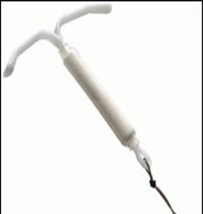
LNG- IUS
Releases Levonorgestrel 20 µg/d
LNG-IUS used for 12 months- decreased dysmenorrhea, pelvic pain, deep dyspareunia and increased degree of patient satisfaction
Reduction in rectovaginal endometriotic nodules
Reduces pain in Adenomyosis
Decreases recurrence post surgery, lower dysmenorrhea
  Effects are similar to GnRH-a on pelvic pain
Option for t/t of pain in adolescents
No post-op benefit in endometrioma
Tanmahasunut et al., Obst Gynecol 2012, Yoost et al., J Pediatr Adolesc Gynecol. 2013,Imai et al., Clin Exp stet Gynecol. 2014

Slide 43
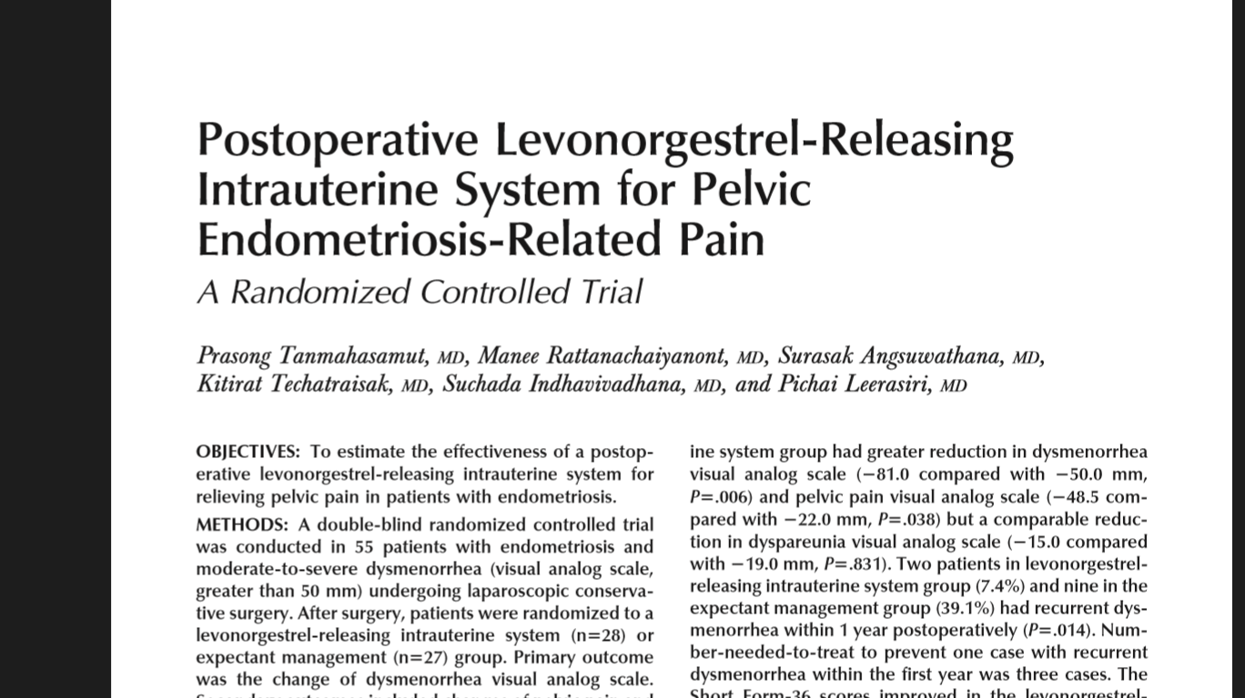
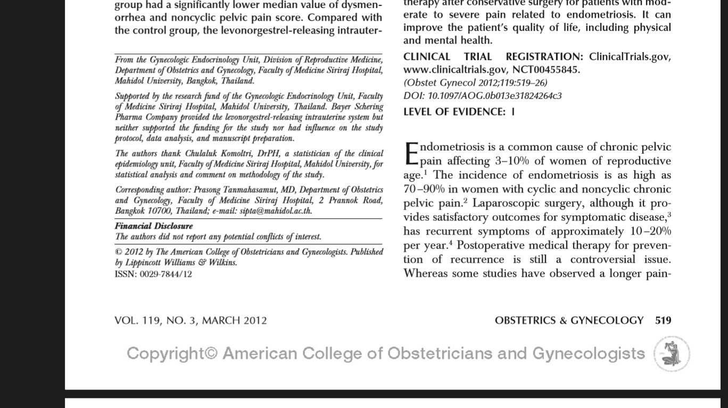
Double blinded RCT
55 patients undergoing conservative laparoscopic surgery for endometriosis
LNG IUD inserted post operatively (n= 28)
Expectant management (n=27)
Duration of follow up- 12 months
RESULTS
 | LNG group | Expectant mgmt. | P value
Dec. in VAS score(mm) | -81 | -50 | 0.006
Dec. in pelvic pain analogue score(mm( | -48.5 | -22 | 0.038
Recurrent dysmenorrhoea | 7.4% | 39.1% | 0.014

Slide 44
Dienogest
19-nor-testosterone derivative with progestogenic and antiandrogenic activity
Dose- 2 mg/d
At a dose of 2mg per day the therapeutic window is achieved with moderate suppression of E2 levels ( kept in range 20-50 pg/ml) avoiding stimulation of lesions and hypoestrogenic side effects on BMD is not seen
Kohler et al. Intl J Gynecol Obstet 2010

Slide 45
Dienogest: Unique chemistry
Dienogest (DNG) is a 19-norprogestin
(derived from 19-nortestosterone)
C
N
H
C
17α-cyanomethyl group
3
O
H
Additional double bond
H
H
= unique characteristics
O
・ Deletion of 17α ethynyl reduced harmful influence on liver function
・ Little influence on blood coagulation
・ No Androgenic, Glucocorticoid, Mineralocorticoid or Hypo estrogenic side effect
Oettel et al, 1995.

Slide 46
Dienogest: Unique effects
Dienogest
Hypothamo-pituitary
Ovary
Endometriotic cells
LH surge
Follicle
development
Suppress Ovarian Function
Suppress Proliferation of Endometriotic cells
Ovulation and Estradiol production
Reduction of Pain
and Lesion size

Slide 47
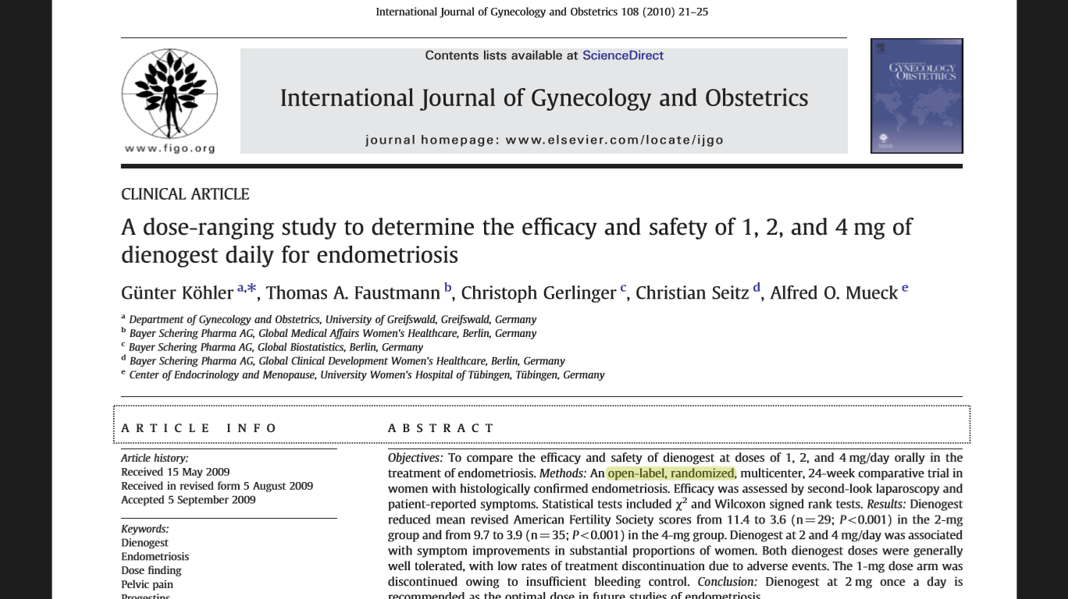
Open-label, randomized comparative trial
Duration of therapy : 24 wks
Women receiving T. Dienogest 4 mg/d : n = 35
T. Dienogest 2 mg/d : n = 29
T. Dienogest 1 mg/d : n = 4 (recruitment discontinued d/t irregular bleeding in all pts.)
Significant ↓ in mean rAFS score from 11.4 to 3.6 ( P <0.001) in 2 mg groupa
Significant ↓ in mean rAFS score from 9.7 to 3.9 (P<0.001) in 4 mg group
CONCLUSION
Dienogest at 2mg /d recommended as optimal dose in future studies of endometriosis

Slide 48
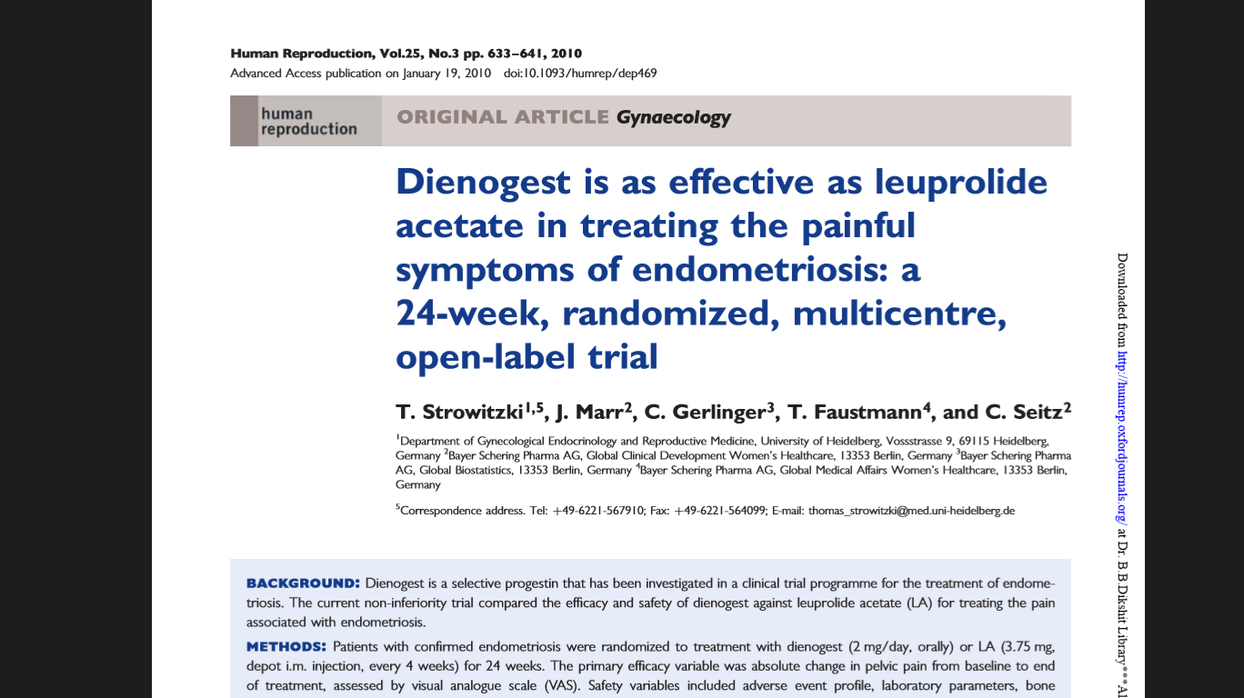
252 diagnosed cases of endometriosis
124 received T. Dienogest 2mg/d
128 received Inj. Leuprolide Acetate (LA) 3.75 mg monthly
Duration of t/t- 24 wks
Results
  Significant ↓ in absolute VAS score with Dienogest compared to LA
  Mean lumbar BMD + 0.25% in Dienogest group
  - 4.04% in LA group (P value 0.0003)

Slide 49
Dinogest Therapy during early stages of recurrence of endoemtrioma
Koshiba et al, J Obstet Gynecol Res 2018
Alternative option to avoid repeat surgeries
After surgery, 146 patients enrolled
16 patients developed recurrence of endometrioma
Patients were put on 24 months of DNG
4 out of the 7 patients- complete resolution of endometrioma
DNG therapy early, after recurrence, is good for reducing risk of repeated surgery
Number of women enrolled | Intervention | Recurrence of endometrioma
83 | No treatment | 12
32 | On OC | 3
27 | On DNG | 1

Slide 50
GnRH Agonist
Mechanism of action
  Initial stimulation of anterior pituitary to release FSH & LH
  Desensitisation & downregulation of pituitary receptors (1-3wks)
  Hypogonadotropic hypogonadic state
Side effects
  -Breakthrough bleeding
  -Hypoestrogenic state- hot
  flushes, vaginal dryness, headache
  -Osteoporosis
GNRH AGONISTS | Route | Dose
Leuprolide (Leuprolin) | I.m./sc depot | 3.75 mg/month 11.25mg / 3 months
Goserelin (Zoladex) | Sc implant | 3.6 mg/month 10.8mg/ 3 months
Triptorelin (Decapeptyl) | I.m. depot | 3.75 mg/month; 11.25mg/ 12 wks
Naferelin (Nasarel) | Intranasal | 400 μg/day
Buserelin | Intra nasal | 900 mcg per day

Slide 51
GnRH- agonist
Luprolide , Goserelin
Profound hypo-estrogenic state for quick pain relief
Limits safety and tolerability
Add back with NETA- increases cost
RCT- 12 week luprolide + NET 2.5 mg given for 48 weeks
  No superior to OC in pain relief
  Costs 18 times ($8,006 vs $454) (Guzick DS et al, FS 2011)
COST ?
Tolerability on S/E ?

Slide 52
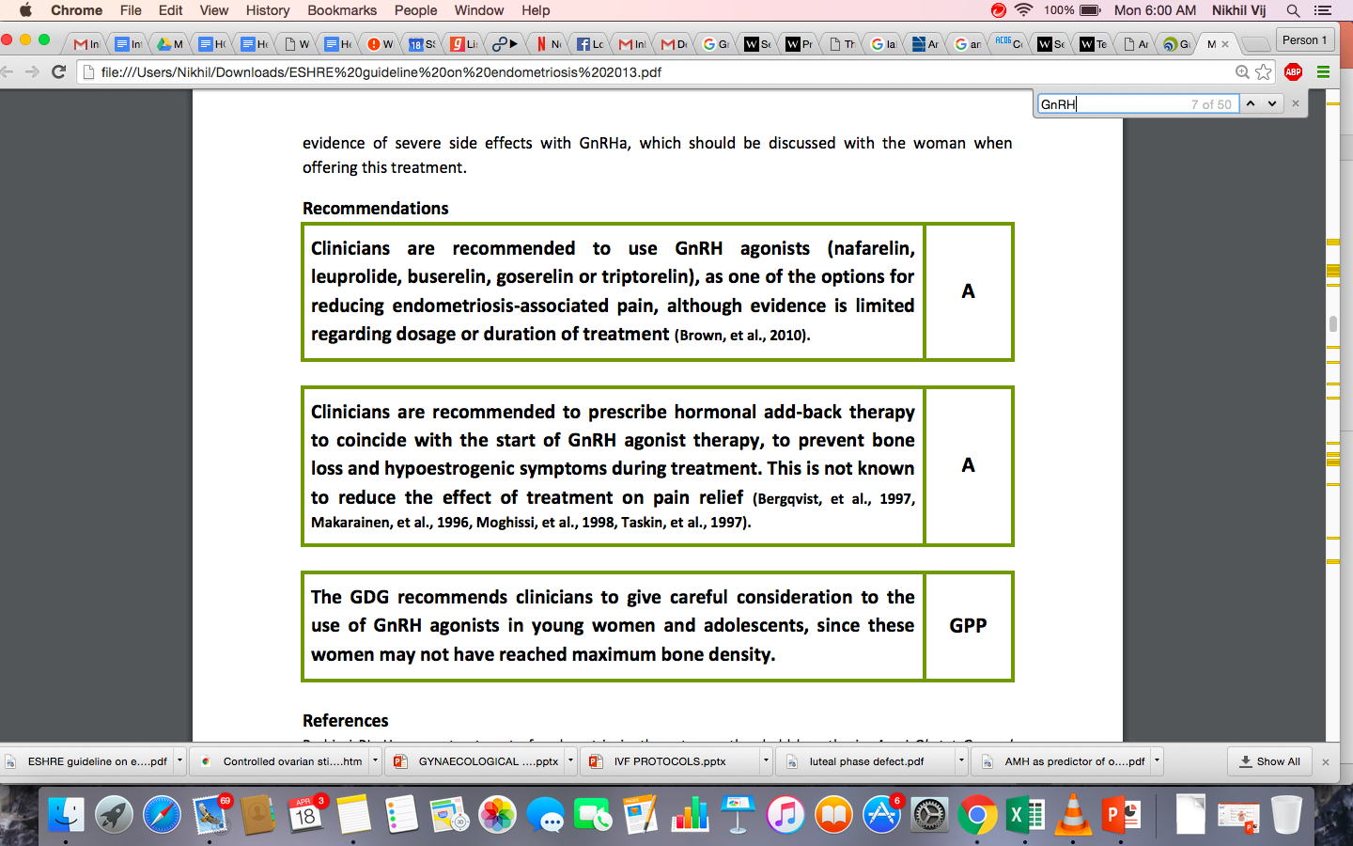
GnRH Agonist & Endometriosis
ESHRE Endometriosis Guideline Development Group, Sep 2013
ESHRE Endometriosis Guideline Development Group, Sep 2013

Slide 53
Add –Back Therapy
“Estrogen threshold hypothesis”(E2 levels 30-50 pg/l)
OPTIONS
High dose Progestrone
  Norethindrone acetate (2.5-5 mg/day)
  MPA (20-100 mg/day)
Low dose combination E+ P
  Estradiol valerate 1 mg PLUS MPA (5 mg)
  Estradiol valerate 1 mg PLUS norethindrone acetate (2.5 mg)
  Transdermal estradiol 25µgm PLUS oral MPA (2.5mg)
Norethindrone acetate (5 mg) PLUS etidronate
Tibilone(2.5mg/day)
Add 1000mg/day of elemental calcium

Slide 54
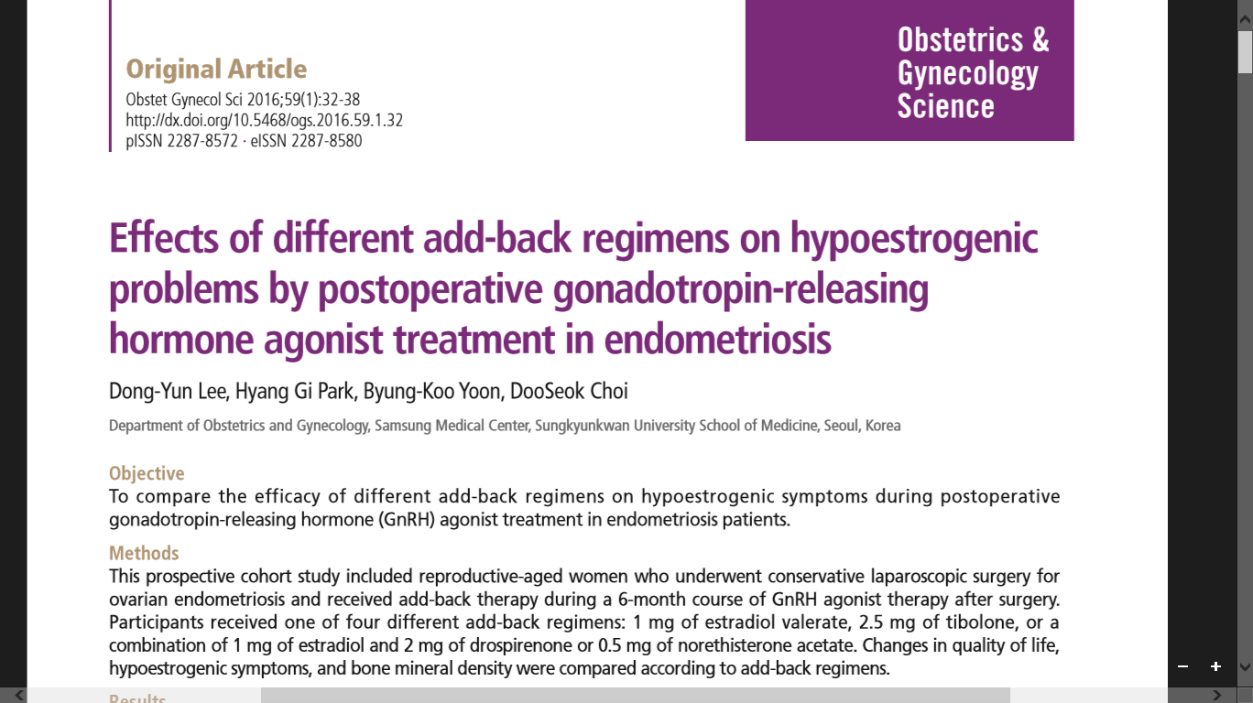
Prospective cohort study
Reproductive age women who underwent conservative laparoscopic surgery for ovarian endometrioma
Period of follow up : 1 month after last GnRH injection, took GnRH for 6 cycles.
Add back therapy started along with 1st dose of GnRH analogue
Drug (dose/d) | No. of subjects
Estradiol valerate(1mg) | 16
Tibolone(2.5mg) | 14
Estradiol V.(1mg) + Drospirenone (2mg) | 13
Estradiol V.(1mg) + Norethisterone acetate(0.5mg) | 14
Incidence of hot flushes significantly reduced in Estradiol +NEE
BMD decreased significantly in all groups except Estradiol +NEE

Slide 55
Pain management- ESHRE 2013
ESHRE Endometriosis Guideline Development Group, Sep 2013

Slide 56
ESHRE Endometriosis Guideline Development Group, Sep 2013

Slide 57
ESHRE Endometriosis Guideline Development Group, Sep 2013

Slide 58
Post-operative medical treatment-ESHRE
ESHRE Endometriosis Guideline Development Group, Sep 2013

Slide 59
Aromatase Inhibitors
Rationale of Therapy:
Aromatase P450
  E biosynthesis
  Conversion of androstenedione and T4 to estrone and estradiol.
Normal endometrium - no aromatase activity
Endometriotic tissue - high levels of aromatase
AI decrease local estrogen synthesis
Inhibit growth of endometriotic implants.
Drugs
Letrozole (2.5 mg/day),
Anastrazole ( 1mg/day)
Fadrozole, Formestane, Exmestane
(Ferrero et al., 2011)

Slide 60
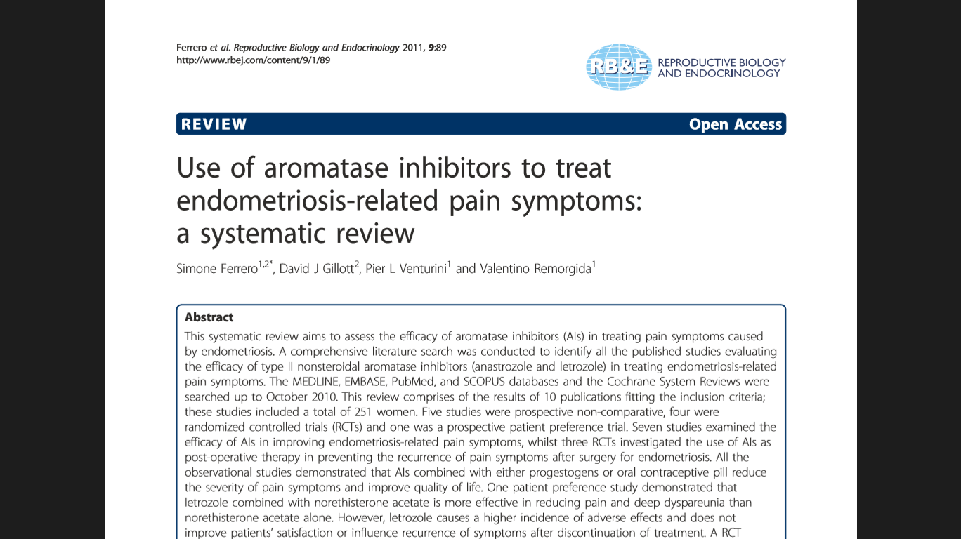
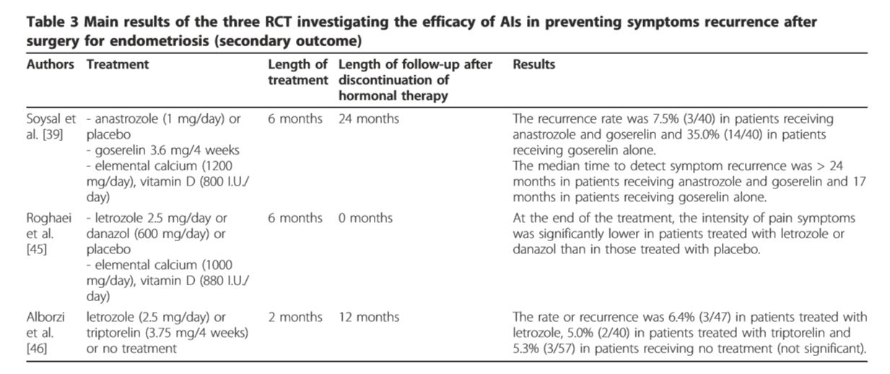
After surgical t/t of endometriosis, AIs combined with GnRH analogue for 6 months reduces risk of endometriosis recurrence when compared with GnRH analogue alone.
AIs effectively reduce severity of endometriosis-related pain symptoms

Slide 61
SERMs
Selective E Receptor Modulators-SERMs
  Non-steroidal that bind to ER-agonist/antagonist
  Endometriosis- antagonist activity on endometium
  -agonist on bone
  Anti-estrogenic effects by inhibiting binding of E2 to ERα and ERβ, as well as suppressing E2–ER transcriptional activation.
  Rat model-↓endometriosis implants without affecting Sr. E2 or ↓ BMD
  Effects in human clinical studies are not yet known.
Raloxifene (SERM) has been shown not to provide benefit
(Stratton et al., 2008)

Slide 62
Anti-Progestins
Mifepristone
Inhibits ovulation
Inhibitory effects on endometrial cells
Only observational studies
Not accepted in clinical practice as yet
Dosage
  50-100 mg- ↓pain, ↓lesions (55%)
  5 mg- ↓pain only

Slide 63
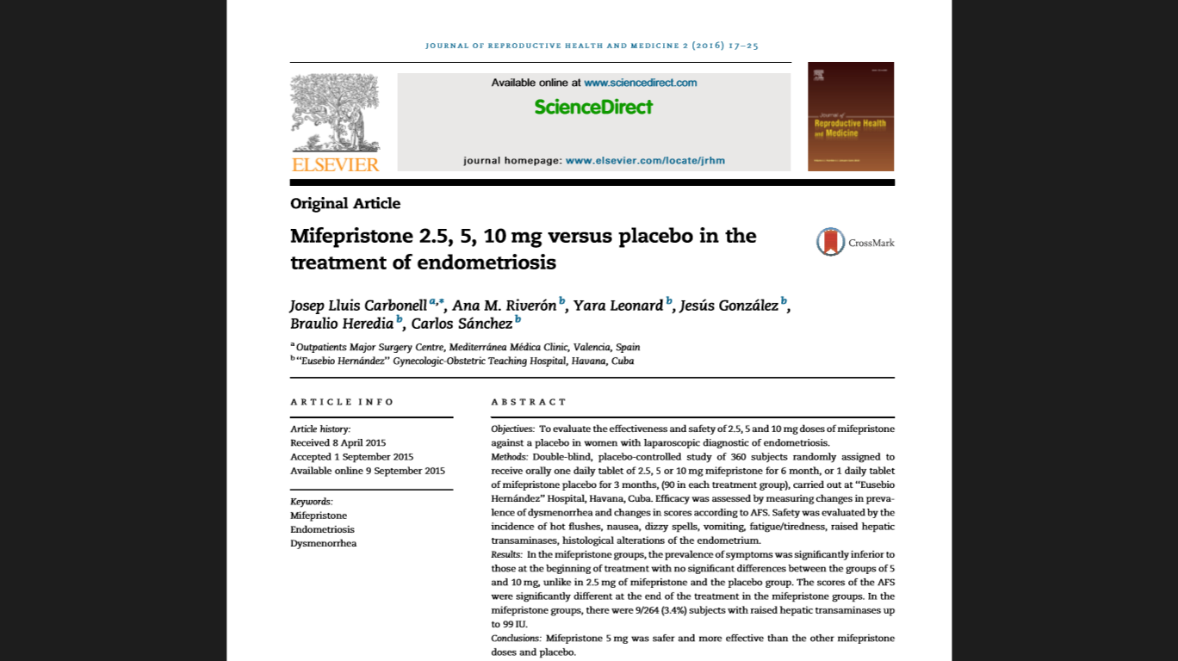

Slide 64
SPRMs –current status
Pain relief without hypo-estrogenic effects
Mifepristone- 50mg/d; 5 mg/d
Asoprisnil- 5, 10,25 mg/d X 12 weeks on trial
PAEC (progesterone receptor modulators associated endometrial changes)- endometrial hyperplasia / atypia (Bediaway et al , 2017)
No strong evidence on practicing as yet
Hold promise for future

Slide 65
Treatment of infertility in endometriosis
Medical
  Hormone therapy
Surgery
Medically assisted reproduction (MAR)
  SO + IUI
  IVF/ICSI

Slide 66
Thank You

